Slide 1
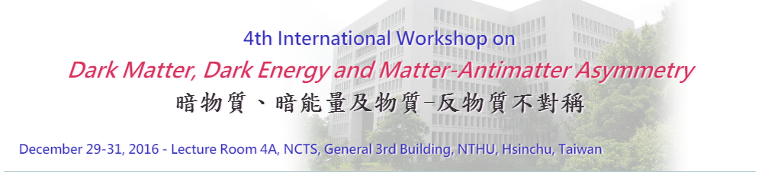

Void alignment and density profile applied to measuring cosmological parameters
Speaker: De-Chang Dai
MNRAS2015 454 (4): 3590-3596(arXiv:1509.07498)

Slide 2
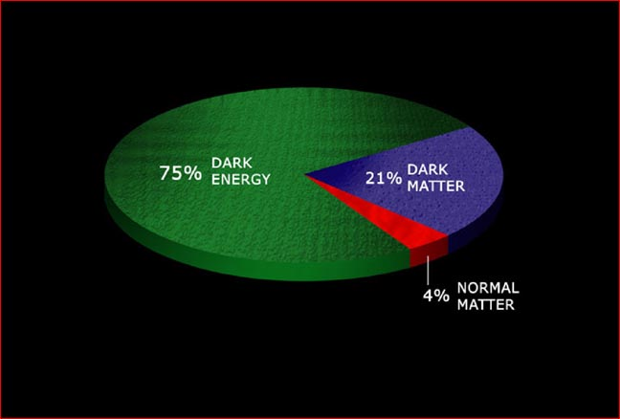
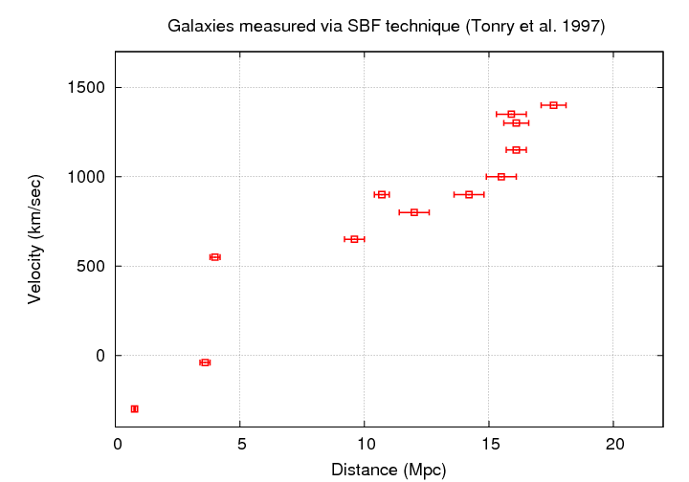
motivation
The voids are highly affected by the evolution of the universe’s energy density components and therefore could be a powerful cosmological probe(Thompson & Gregory 2011).
Whether cosmological constant is actually a constant.

Slide 3
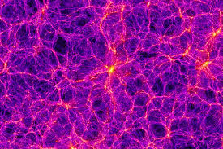
Void: a low matter density region

Slide 4
Methods for finding voids
VoidFinder Algorithm
ZOBOV (Zone Bordering On Voidness) Algorithm
DIVA (DynamIcal Void Analysis) Algorithm

Slide 5
Data:SDSS10
Public Cosmic Void catalogue(Sutter et al )

Slide 6
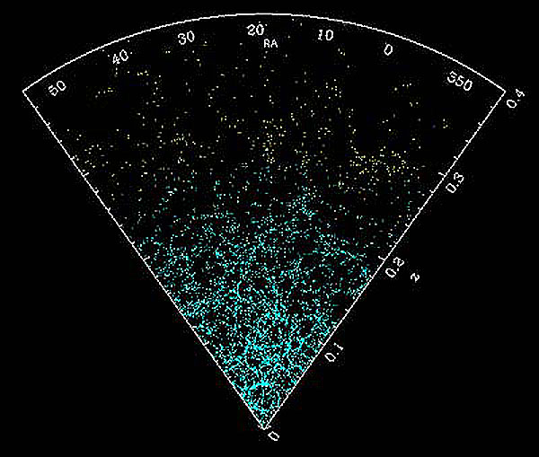
Cosmology 101:
The universe is homogeneous and isotropic.

Slide 7
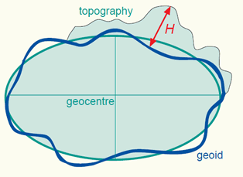
Any structure in the universe has no prefer direction.
Ellipsoid approximation

Slide 8
What a homogeneous distribution looks like
θ is the angle between its orientation direction and line-of-sight

Slide 9
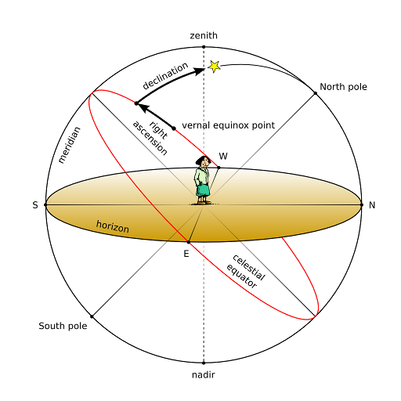
Model: dark matter and dark energy universe
Celestial coordinates
measurement: z, Dec, Ra

Slide 10
If the model is not correct:

Slide 11
< cosθ > in different ΩΛ (dr10cmass3)

Slide 13
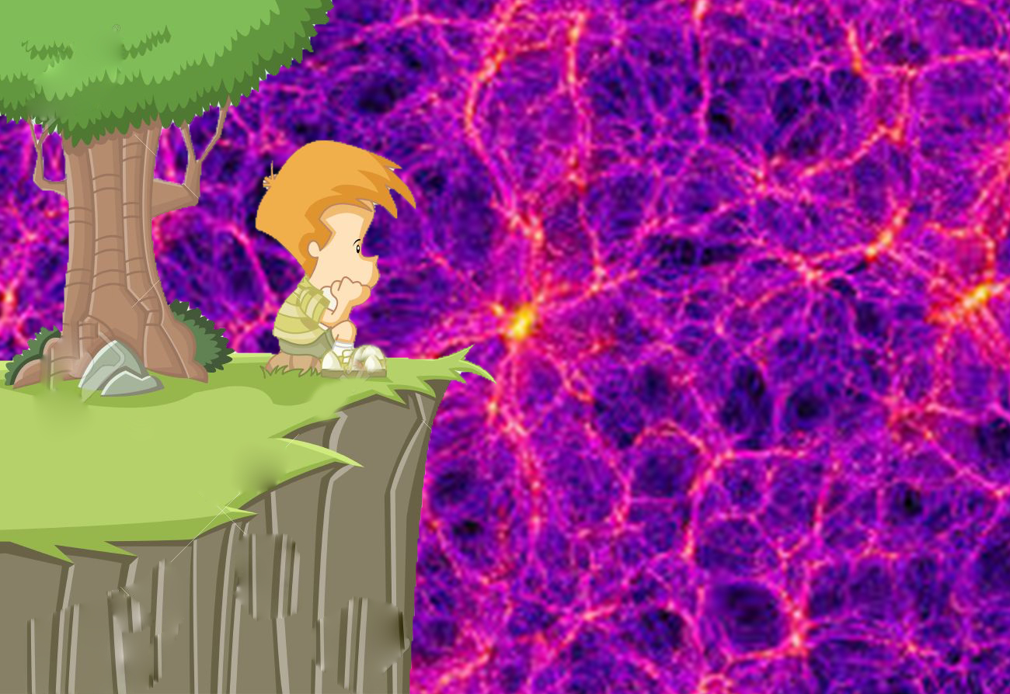
Is it all what we can do?

Slide 14
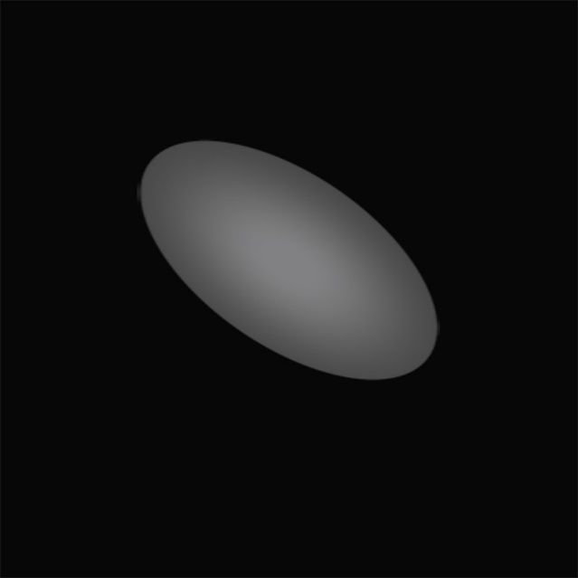
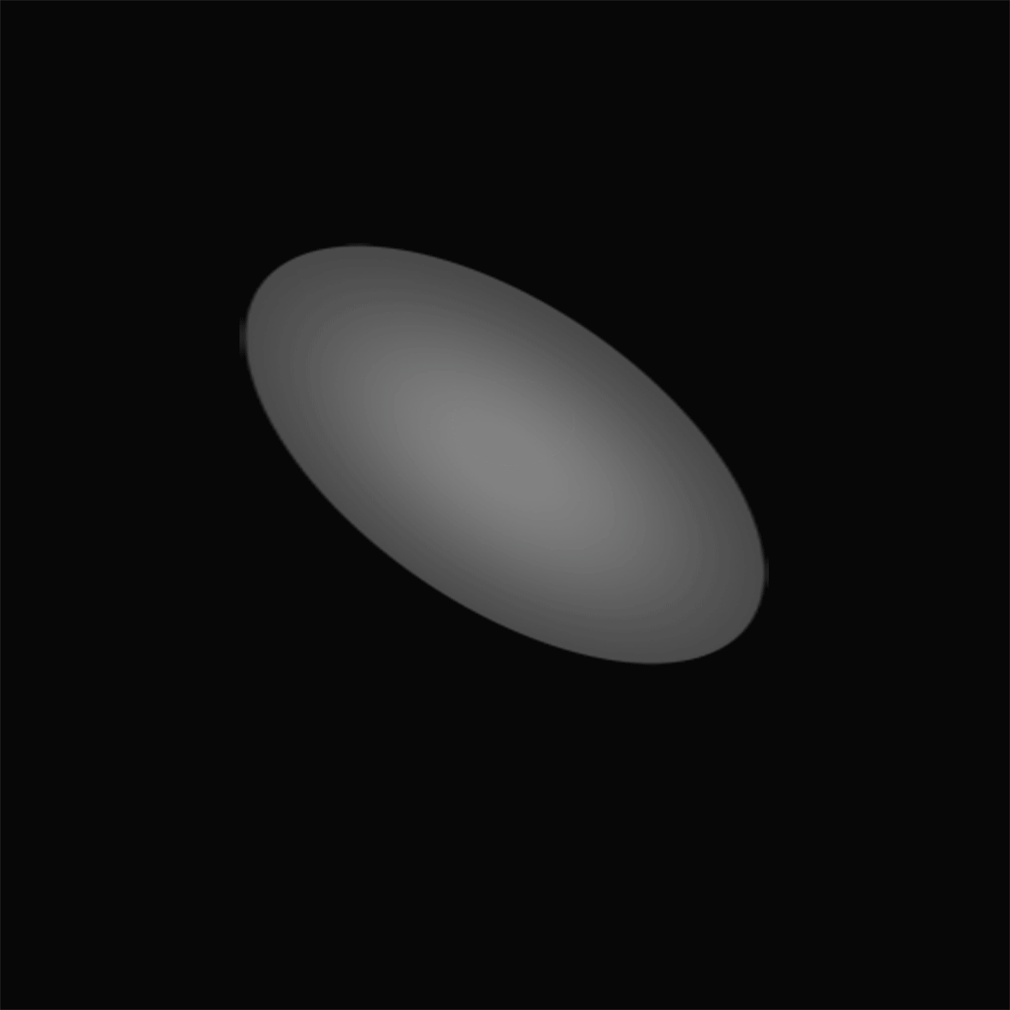
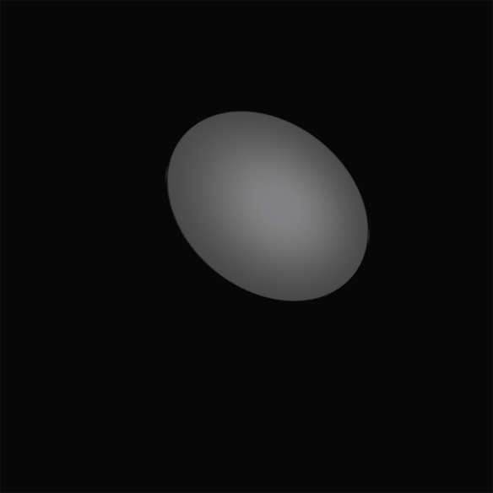
Stacking

Slide 15
On the universality of void density profiles (Ricciardelli et al)
Dependence of the simulated void density profiles

Slide 16
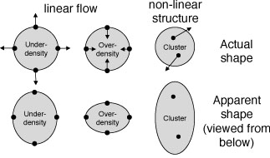

Slide 17
Void density profile

Slide 18
After stacking
dr10mass2

Slide 19
Stacking and best fit

Slide 21
Possible improvement in the future

Slide 22
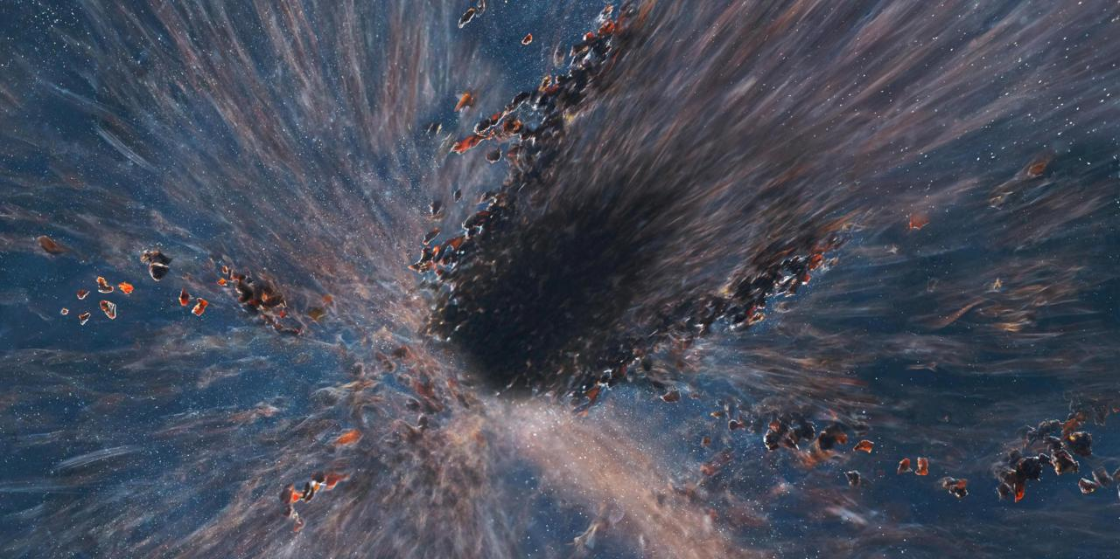
Summary
It is possible to measure cosmological component through void structure.
A better void density profile function is needed.

Slide 23
Thank you very much

